Slide 1

Online Bookstore

Slide 2
Title and Content Layout with List
Methodology:-
Location Analysis:
All over India
Project Scope and Objectives:
Providing students easy,quick and low price buying of books.

Slide 3
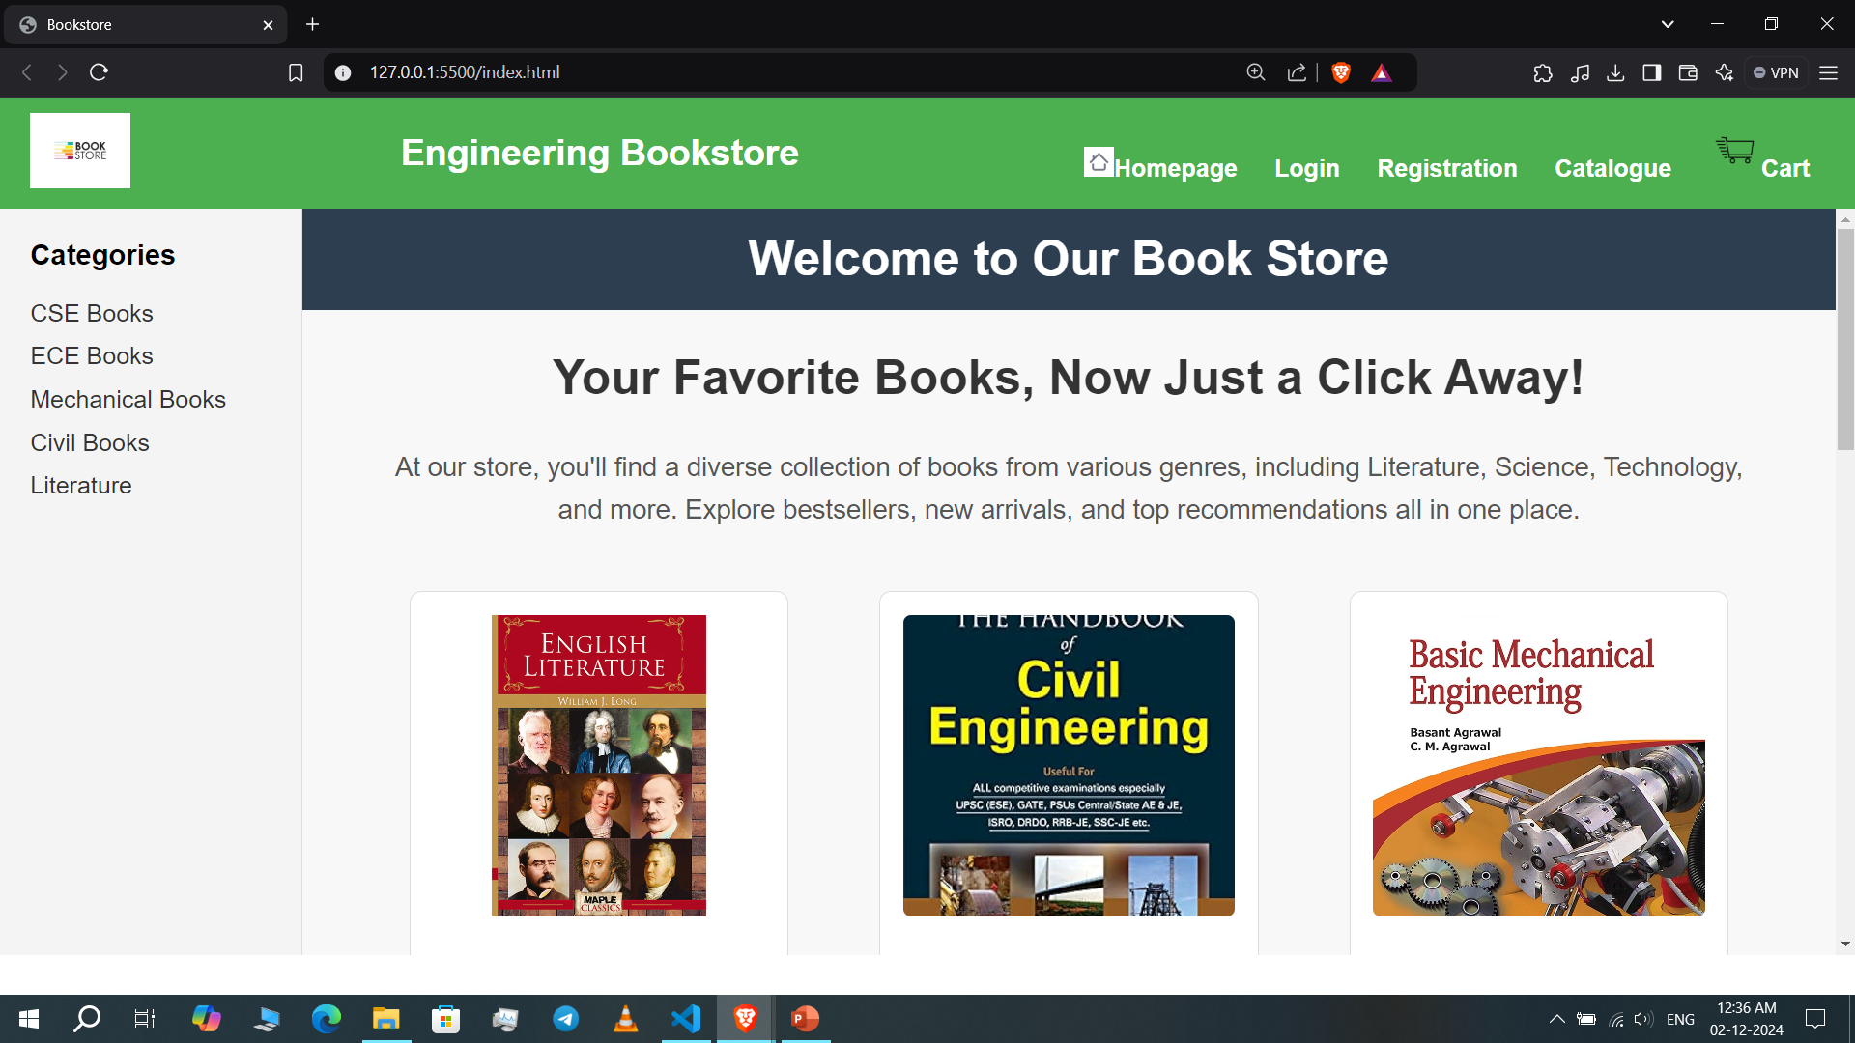
Interface
HOME PAGE

Slide 4
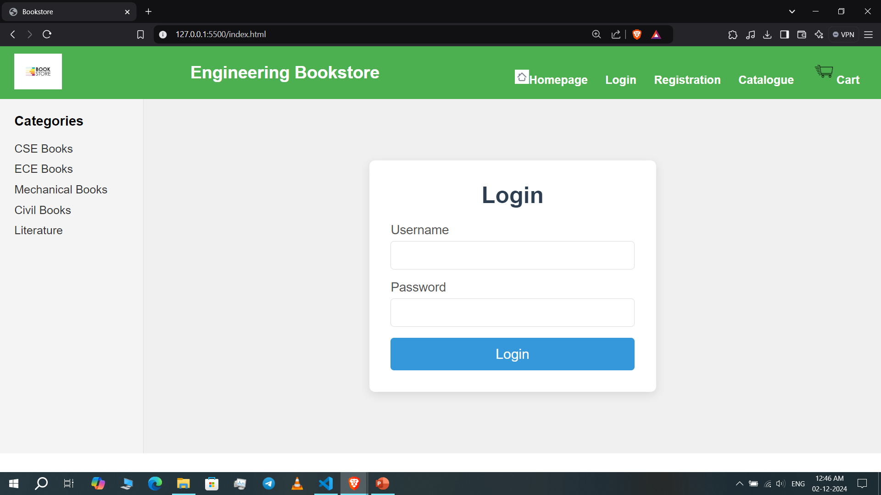
LOGIN PAGE

Slide 5
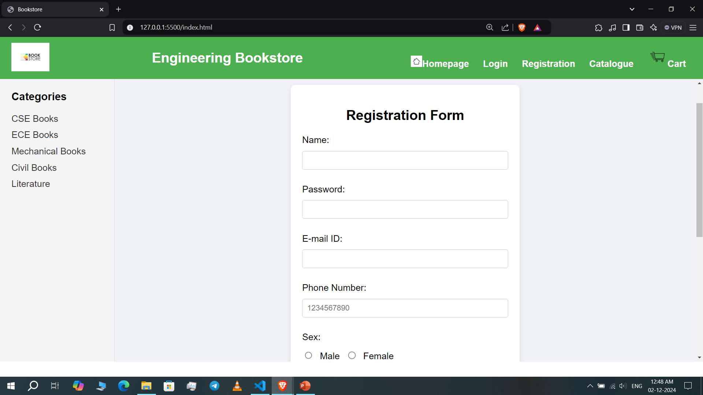
REGISTRATION PAGE

Slide 6
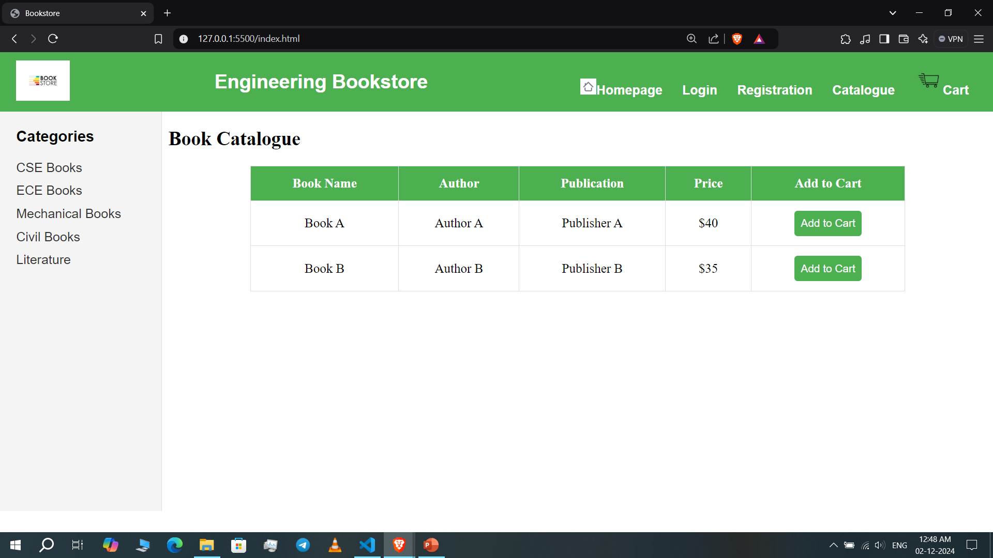
CATALOGUE PAGE

Slide 7
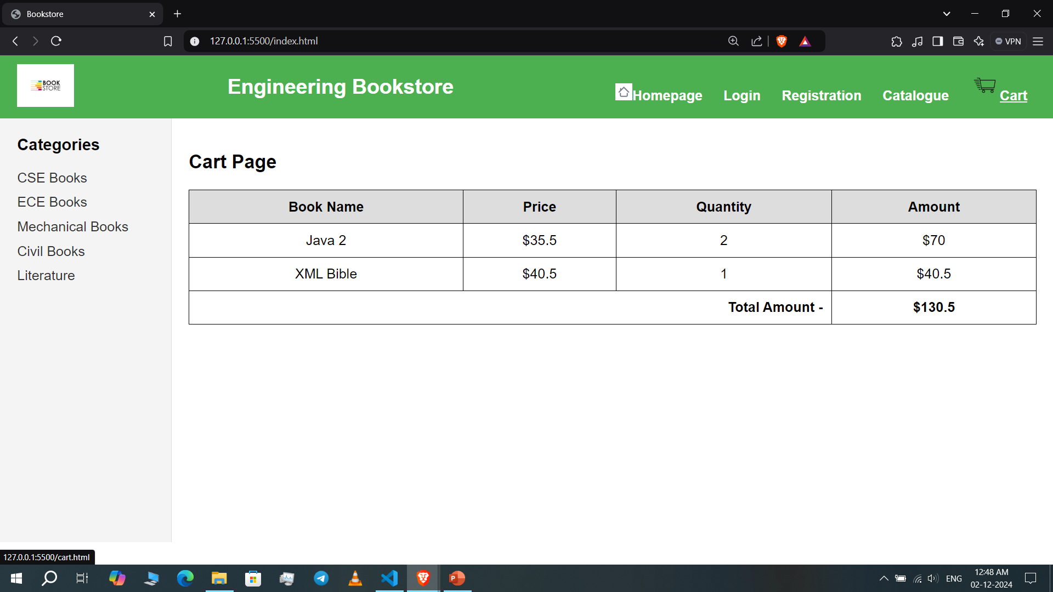
CART PAGE

Slide 8
Software
Frontend: HTML, CSS,

Slide 9
BENEFITS
1. Affordable Access to Resources: By offering books at lower prices, students can easily access the academic and reference materials they need without the financial burden that often comes with purchasing textbooks.
2. Discounts and Promotions: Our online bookstores provide discounts, sales, or student-specific offers, helping students save money and access the materials they need for their courses.
3. Wider Selection: Our Online stores offers a larger inventory, providing students with a broader selection of textbooks, study guides, and other educational materials, including e-books, which are often more affordable.

Slide 10
Conclusion
In conclusion, this mini project on a bookstore for students successfully addresses the needs of both students and bookstore owners by providing features such as book categorization, inventory management, and a user-friendly purchasing system.
It simplifies the book shopping experience for students while ensuring real-time updates on stock availability.
The project improved my technical skills in areas like database management and interface design.
Overall, the system is an efficient solution for managing bookstore operations and enhancing students' access to academic resources.

